Slide 1
Information Technology Project Management
by Dr. Fadi Fayez
Modified version of Jack T. Marchewka text book slides
1-<number>

Slide 2
Objectives
Define IT project and project management terms
Measure the impact IT projects have on an organization
Describe roles and interests of project stakeholders
Explain project life cycle & the systems development life cycle
Describe Project Management Body of Knowledge (PMBOK)
1-<number>

Slide 3
Improving the likelihood of IT Project success
A value driven approach
Socio-technical Approach
Project Management Approach
  methodology : processes and infrastructure
  resources : cost, schedule must be set and controlled
  expectations : quality product / service
  competition
  efficiency and effectiveness : support from all levels in the organization
Knowledge Management Approach
  lessons learned lead to best practices
1-<number>

Slide 4
Important Definitions
  A project is a set of tasks undertaken to accomplish a unique purpose
  Project management is knowledge, skills, tools, and techniques to project activities in order to meet or exceed stakeholder expectations
  Project manager A person assigned by the performing organization to achieve the project’s objectives
1-<number>

Slide 5
Project Main Variables / Attributes
Time Frame: Beginning and ending
Purpose : Results or accomplishments
Ownership: The people (stakeholders) who own the projects
Resources: :Time, money, people, technology, etc.
Roles: (Manager, sponsor, subject matter expert, technical expert)
Risks & Assumptions: (Risks: Internal, external)
Interdependent tasks: (Tasks dependency)
Organizational change
Operating Environment: (Project team understanding organization’s culture, environment, politics, etc)
1-<number>

Slide 6
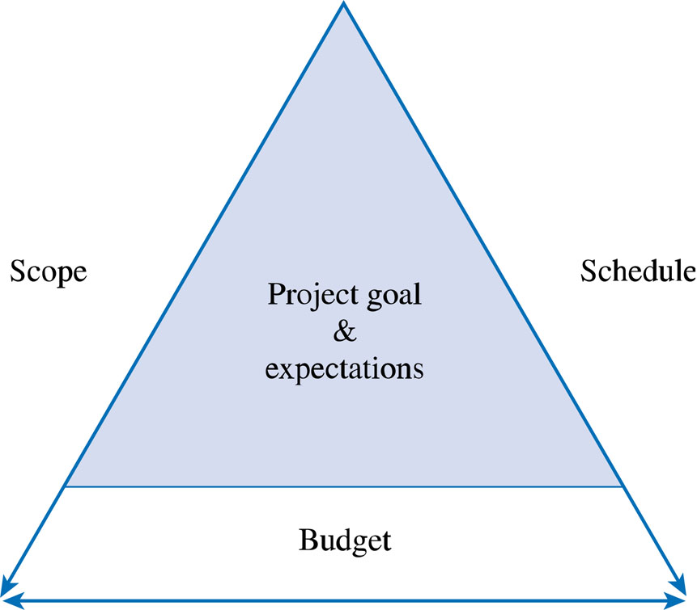
Understanding Resources:
The Triple Constraint
1-<number>

Slide 7
The Project Life Cycle and
IT Development
Related Definitions
Project Life Cycle (PLC)
Deliverable
Phase exits, stage gates, or kill points
Fast tracking
1-<number>

Slide 8
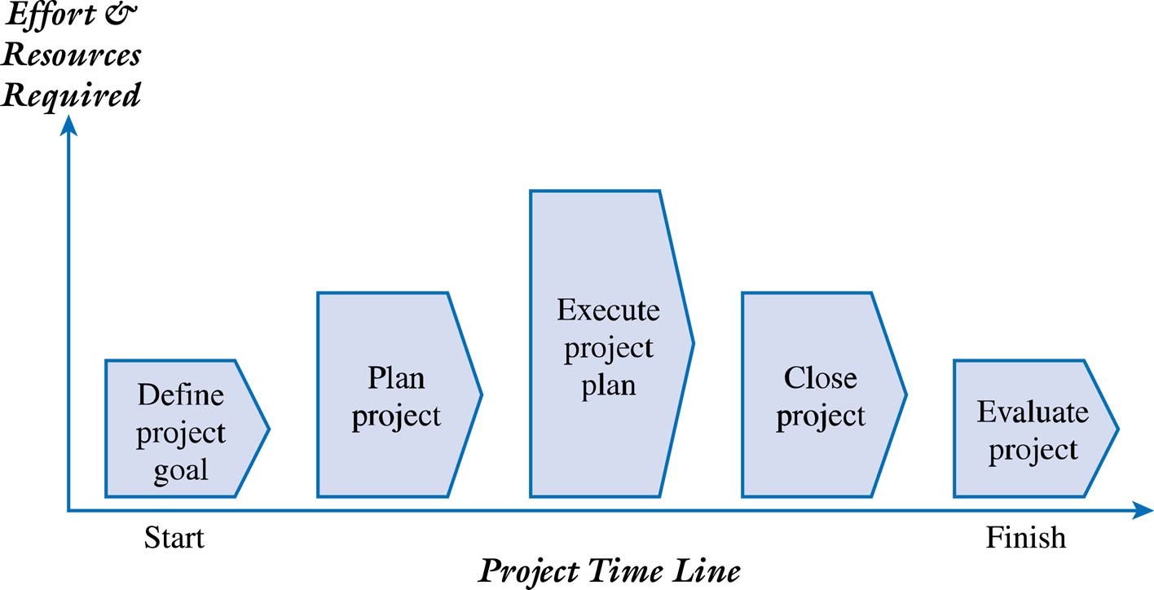
Generic Project Life Cycle (PLC)
1-<number>

Slide 9
Phases of PLC
Define project goal : Focus on providing the business value for the organization. Common characteristics for projects
  Cost is low when the project starts and increases as the project work is done
  Risks and uncertainty are high in the start of the project and they get reduced when the project’s goals are defined
  The stakeholder effect is high at the beginning of the project
Plan project: Questions (What, why, how, who, et al)
  Baseline plan : Defines tasks, resources, deliverables, budget, etc
Execute project: Put plan into action and document progress for comparison with baseline plan
Close project : Formal acknowledgment from sposor
Evaluate project : The product, project team, tasks, etc
1-<number>

Slide 10
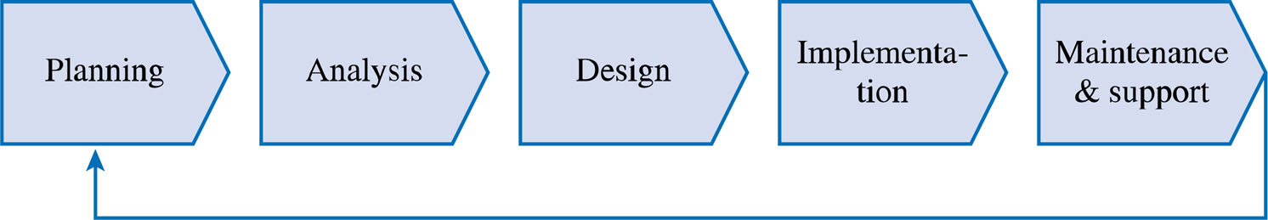
Systems Development Life Cycle (SDLC)
SDLC: sequential phases or stages an information system follows throughout its useful life.
1-<number>

Slide 11
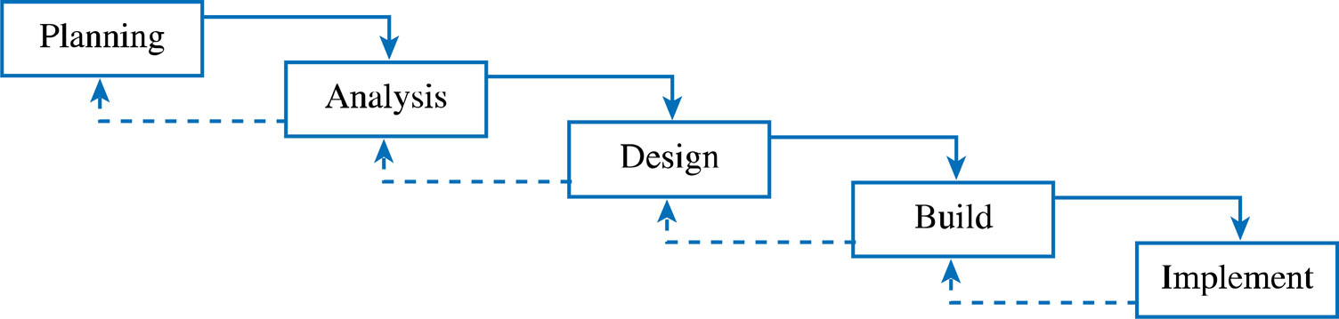
Implementing SDLC:
Structured Approaches:
Waterfall Method
1-<number>

Slide 12
Implementing SDLC:
Rapid Application Development (RAD) Approaches:
Prototyping : Developers and users work together to develop partial or full functional IS
Spiral Development : Risk oriented approach where a project is decomposed into sub-projects each address one or a group of risks
Extreme Programming : A system is transferred to the users in versions. Small groups of developers working closely and interacting with users
1-<number>

Slide 13
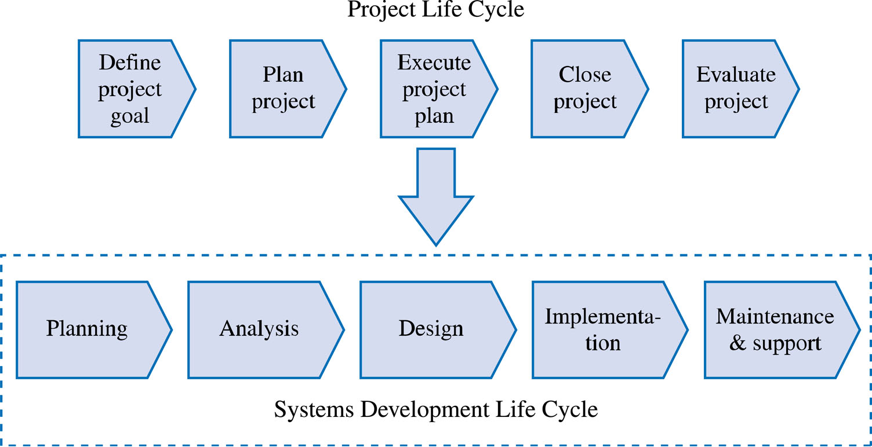
The PLC vs the SDLC
1-<number>

Slide 14
Project Management Knowledge Areas
Project integration management
Project scope management
Project time management
Project cost management
Project quality management
Project human resource management
Project communication management
Project risk management
Project procurement management
1-<number>

